Slide 1
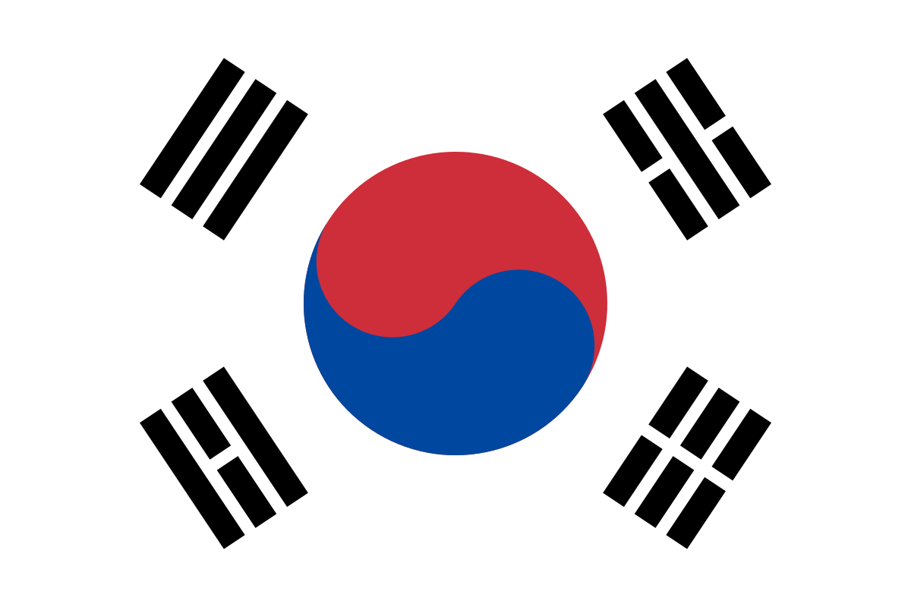

Slide 2
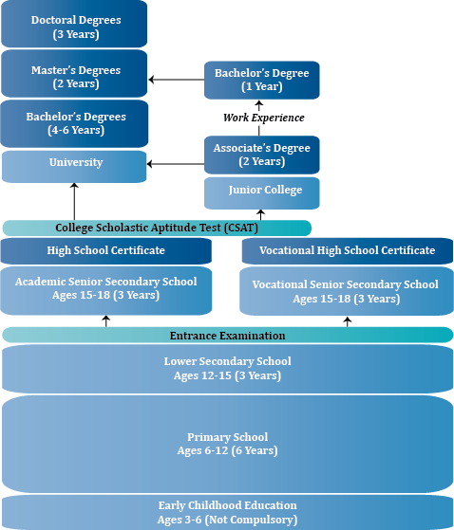

Slide 3
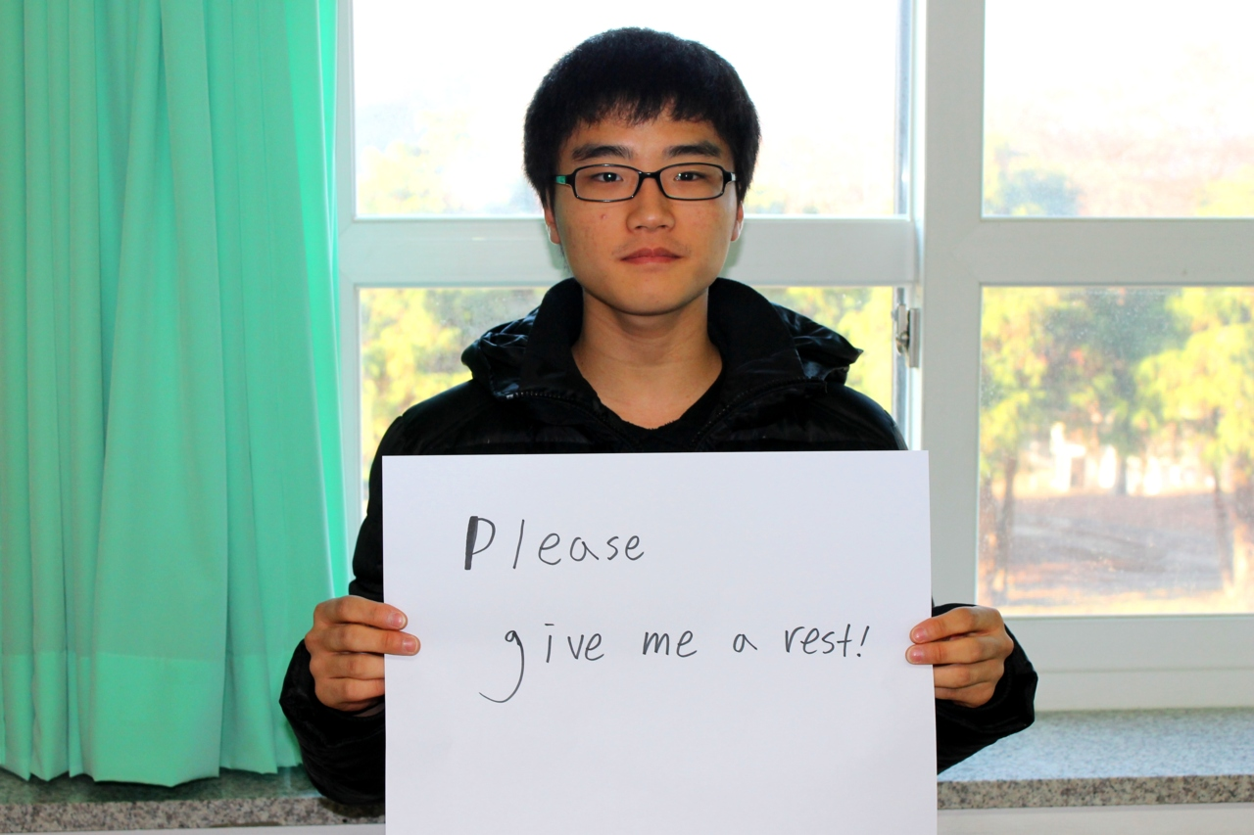
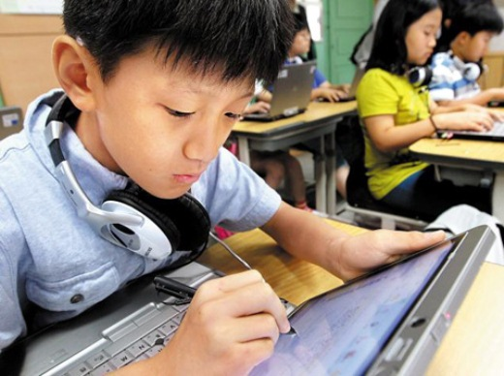
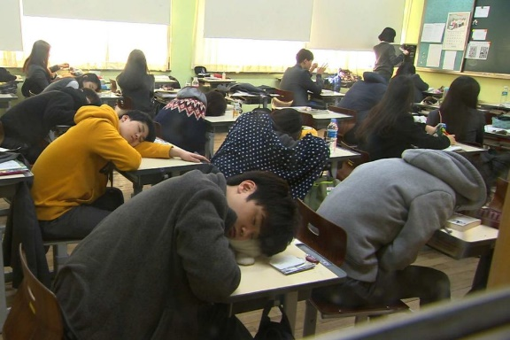
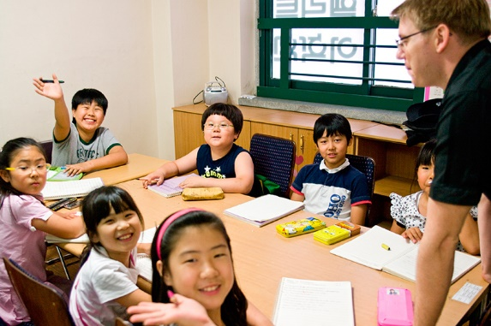
General Discussion

Slide 4
“SETH DOANE: Twenty-two-year-old Seung Jun-Yang says a typical school day starts at seven, and kept him studying past 1 AM.”
References
SCOTT, P., & SETH, D. (n.d). Average American school teacher makes fifty-six thousand dollars a year. CBS Evening News With Katie Couric,

Slide 5
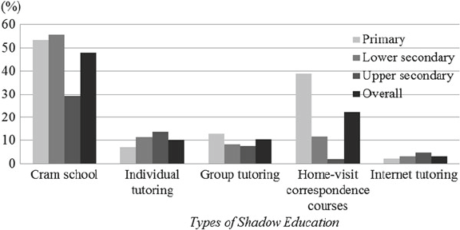
Cram schools are a large part of this
Figure 2: Prevalence of shadow education in Korea, 2010
(Source: KNSO 2011)
Shadow education: “paid private supplementary tutoring or coaching aimed at providing additional help to students outside of school mainly to prepare for a variety of examinations
(Source: https://www.researchgate.net/figure/Prevalence-of-shadow-education-in-Korea-2010-Source-KNSO-2011_fig1_275582846)

Slide 6
Hagwon (Cram schooling system in Korea) (Chinese: 学院)
Children: 16-hour school days and not getting home until midnight (https://grrrltraveler.com/10-facts-korean-school/)
Goal: getting into reputable college or university
Parents: plough money into private tuition – over 18 trillion won ($15 billion) in 2014, or more than a tenth of household spending – to improve their children’s chances of getting into the best secondary schools.

Slide 7
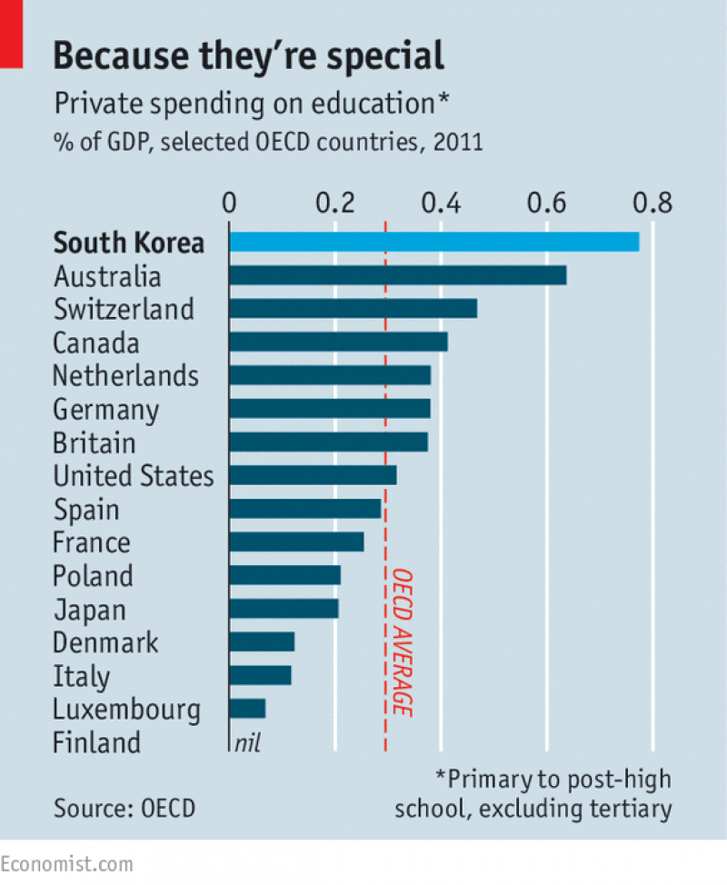
Figure 3: Private spending on education
The government has to ban hagwon from teaching after 10pm and requires them to tell the government how much they charge.
Since 2014, hagwon has been prohibited from advertising that they teach ahead of the school curriculum, while schools have been prohibited from teaching ahead of the school curriculum.
(Source: https://www.economist.com/asia/2015/09/19/the-creme-de-la-cram)
Over 3,000 new hagwon opened in 2014, adding to 30,000 existing ones in 2015.

Slide 8
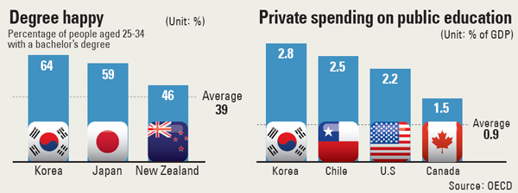
Highest percentage of young people with high school diplomas and bachelor’s degrees among the member countries of OECD.
98% of Koreans aged 25-34 graduated from high school as of 2011.
64% graduated from college or graduate school, according to the OECD’s annual Education at a Glance survey 2013, highest among the world’s 42 leading economies.
(Source: http://koreajoongangdaily.joins.com/news/article/article.aspx?aid=2974121)

Slide 9
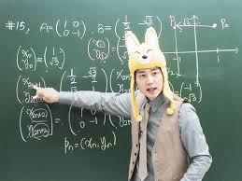
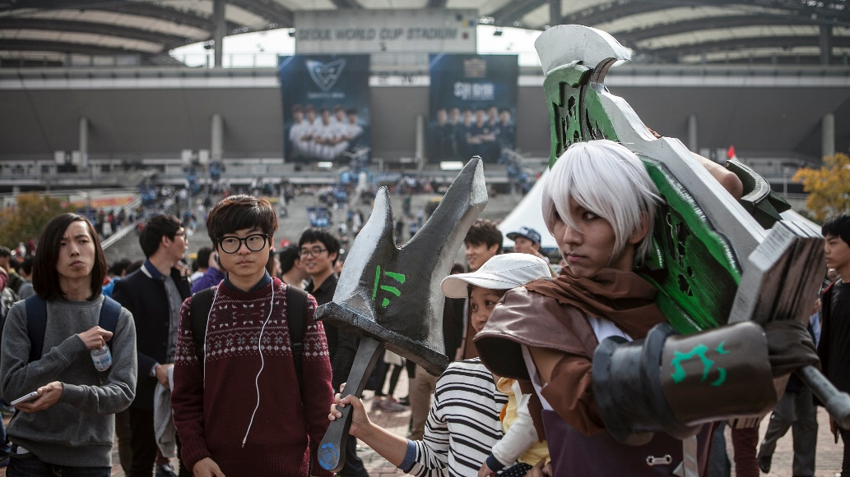
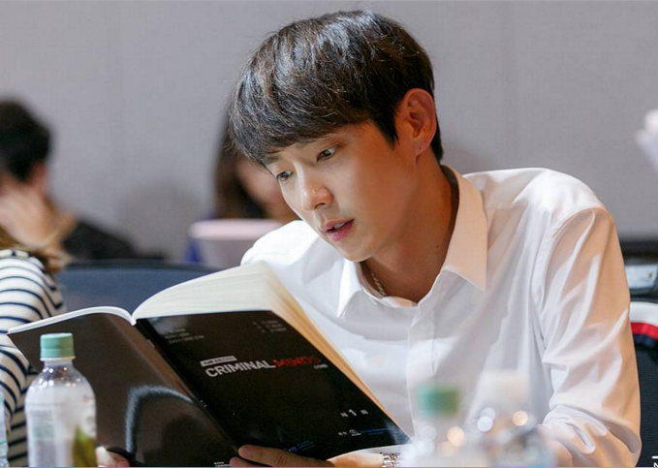
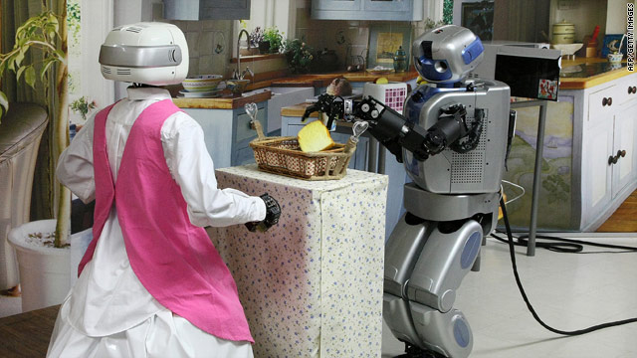
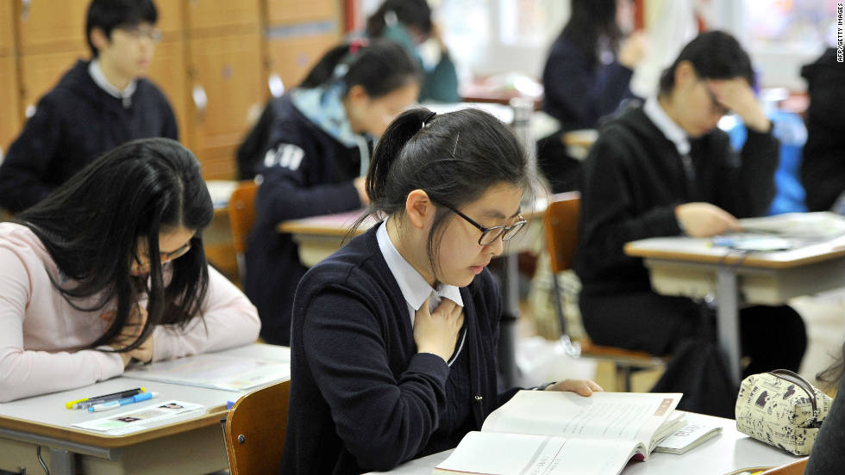
Where does South Korea outperform most other countries?
References
Blazer, C., & Miami-Dade County Public Schools, R. S. (2012). Is South Korea a Case of High-Stakes Testing Gone Too Far? Information Capsule. Volume 1107.

Slide 10
Where does South Korea outperform most other countries?
Maths
Creativity
References
Blazer, C., & Miami-Dade County Public Schools, R. S. (2012). Is South Korea a Case of High-Stakes Testing Gone Too Far? Information Capsule. Volume 1107.
Reading
Innovative thinking
Tests

Slide 11
An analysis points the finger at rote memorization and the use of a single test to enter university. Seeing the academic success of this country, American policy makers seek to emulate them, while South Korea is trying to westernize its system.
Both countries are not looking for a combination of both systems.
References
Blazer, C., & Miami-Dade County Public Schools, R. S. (2012). Is South Korea a Case of High-Stakes Testing Gone Too Far? Information Capsule. Volume 1107.

Slide 12
Certainly, some foreigners are certainly doing well in this environment, but it is not a happy environment for the students. One American teacher, Kim says, students spend too much time studying the wrong way- learning lessons by rote that don`t apply to real life. While an international educational poll ranks Korean students at the top for academics, they`re at the bottom for happiness. Kim is trying to change that.”
References
SCOTT, P., & SETH, D. (n.d). Average American school teacher makes fifty-six thousand dollars a year. CBS Evening News With Katie Couric,

Slide 13
Korea is looking in all directions for solutions

Slide 14
Today more schools are becoming privatized in South Korea
With the start of a high school choice program in 2010, the Seoul Local Education Authority privatized a significant proportion of publicly-run private schools. They were able to run themselves and make their own decisions. They subsequently changes their practices and curriculum. This has also prompted a move to hire teachers with less experience as a cost saving measure.

Slide 15
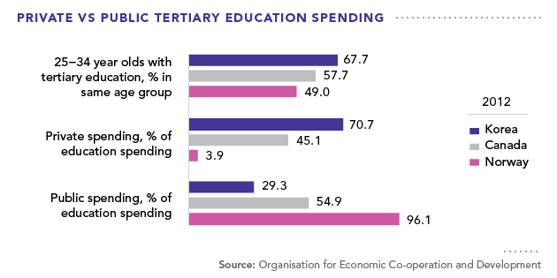
Figure 1: Private versus Public spending on education in Korea, Canada and Norway
The Koreans care about their children’s education as much as people in other well-developed countries, which are famous for their high-quality education systems.
(Source: https://asiapacificcurriculum.ca/learning-module/asia-profiles-south-korea)

Slide 16
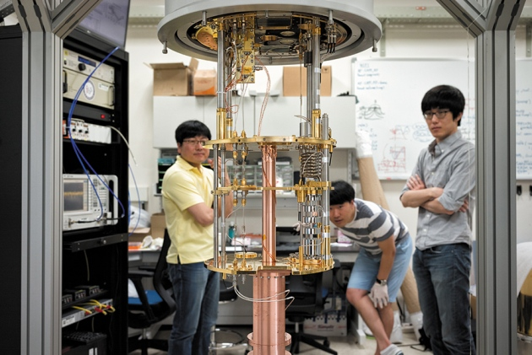
Individual case studies
A trial of problem based learning –
Students' perceptions and satisfaction level of hybrid problem-based learning for 16 years in Kyungpook National University School of Medicine, Korea showed that showed a 78%-93% preference to this model of learning.
The author further points out that in order to be successful, it is important to create a safe atmosphere so that students can engage actively in problem based learning sessions.
References
Sanghee, Y., & Bong Hyun, C. (2016). Students' perceptions and satisfaction level of hybrid problem-based learning for 16 years in Kyungpook National University School of Medicine, Korea. Korean Journal Of Medical Education, 28(1), 9-16. doi:10.3946/kjme.2016.4

Slide 17
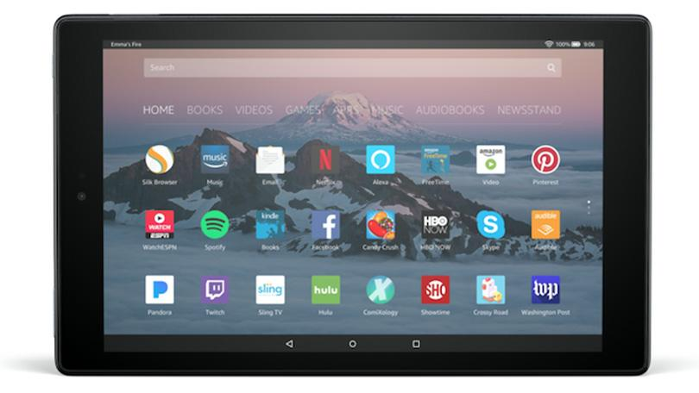
Individual case studies
Fostering Creativity in Tablet-Based Interactive Classrooms
After using tablets in one classroom in Korea, for a semester, with 6 control classes, it was found, through torrance Tests of Creative Thinking-Figural form, that students became more creative than their peers.
References
Hye Jeong, K., Ji Hyeon, P., Sungae, Y., & Hyeoncheol, K. (2016). Fostering Creativity in Tablet-Based Interactive Classrooms. Journal Of Educational Technology & Society, 19(3), 207-220.
Further reading for the creative thinking test - http://www.ststesting.com/ngifted.html

Slide 18
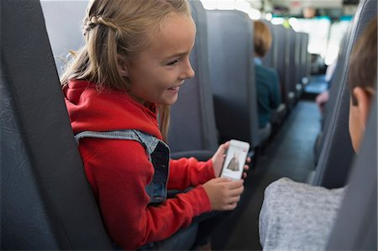
Another possible solution is to shadow the changing habits of the learning base
The Application of a Cloud-Based Student, Teacher, and Parent Platform in English as a Foreign Language Education. A study in Taiwan showed that the use of cloud based learning, with parental participation alters attitudes towards learning within one month.
From Bus Ride to Bedtime, Education Technology Engages Students After the Bell Rings, an article that shows students’ active engagement in learning long after the lessons have finished
References
Chiu, F. (2014). The Application of a Cloud-Based Student, Teacher, and Parent Platform in English as a Foreign Language Education. Turkish Online Journal Of Educational Technology - TOJET, 13(3), 178-187.
References
PR, N. (2016, October 4). Deloitte Survey: From Bus Ride to Bedtime, Education Technology Engages Students After the Bell Rings. PR Newswire US.

